Slide 1


Team Design Project and Skills Final Report
Delivered by Team 41 “Furious”
🚗
🚗
🚗
2023.02 – 2023.06

Slide 2
Team Design Project and Skills Final Report
1
Top-level structure
2
Implementation
Sensor system
Executive control system
Contents
Communication system
Peripheral and mechanical structure
3
Integration
Patio 1
Patio 2
4
Team organization and time schedule

Slide 3
Top-Level Structure
TOP-LEVEL
STRUCTURE
Part 1 :
From Tizzy(Luo Jiaqi)

Slide 4
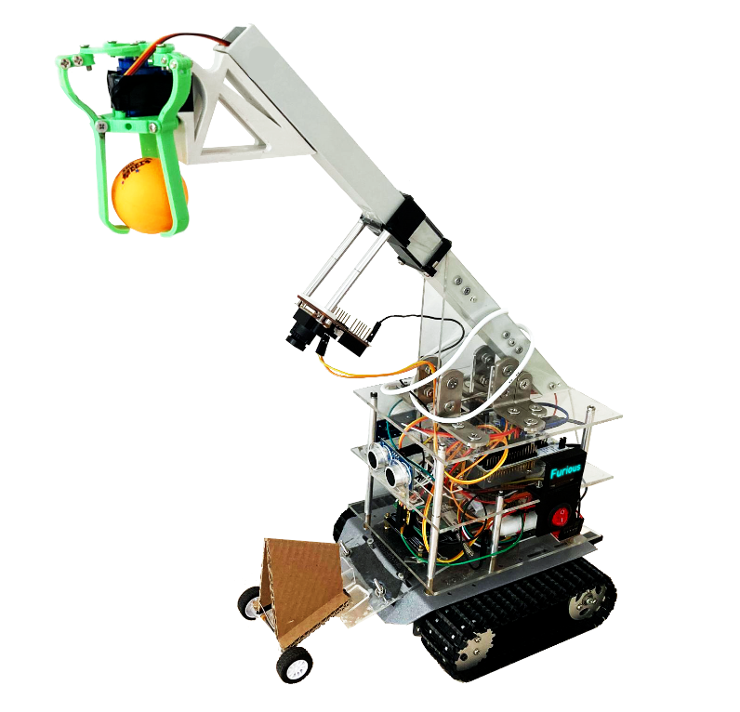
Top-Level Structure
Overview of the robot:
Mechanical arm
Carry & Release tennis ball
Auxiliary wheel & baffles
Prevent flipping forward
Knockout the stand
Not stuck in the fence
ON/OFF Switch

Slide 5
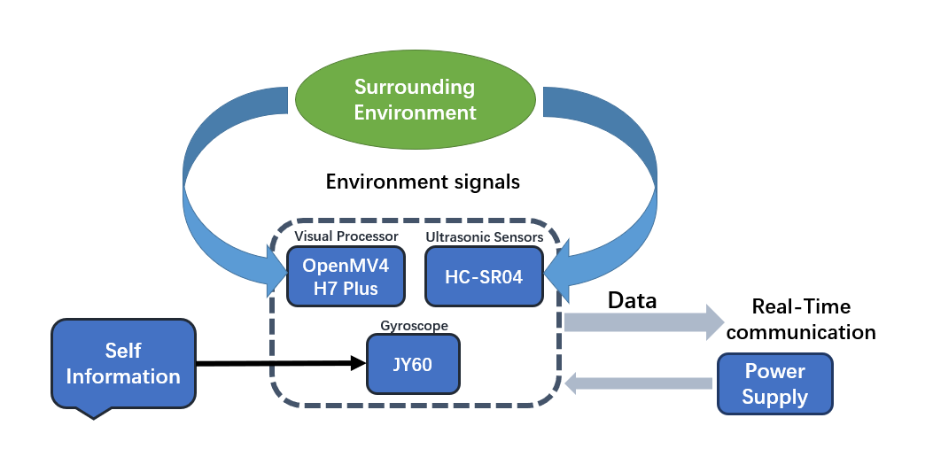
Top-Level Structure
Sensor System:

Slide 6
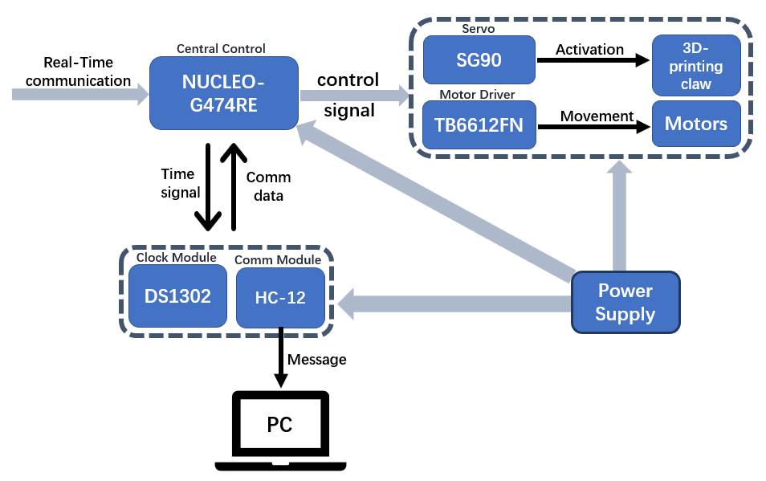
Top-Level Structure
Mechanical & Communication System:

Slide 7
Implementation
Implementation
Part 2 :
From Matt(Wang Jiaqi)&Nina(Li Ruixuan)
Rich(Wang Ruiqi)&Rui(Liu Jingrui)
Timi(Guo Yixiao)&John Zeng(Zeng Yu)
John Zhang(Zhang Jinyang)

Slide 8

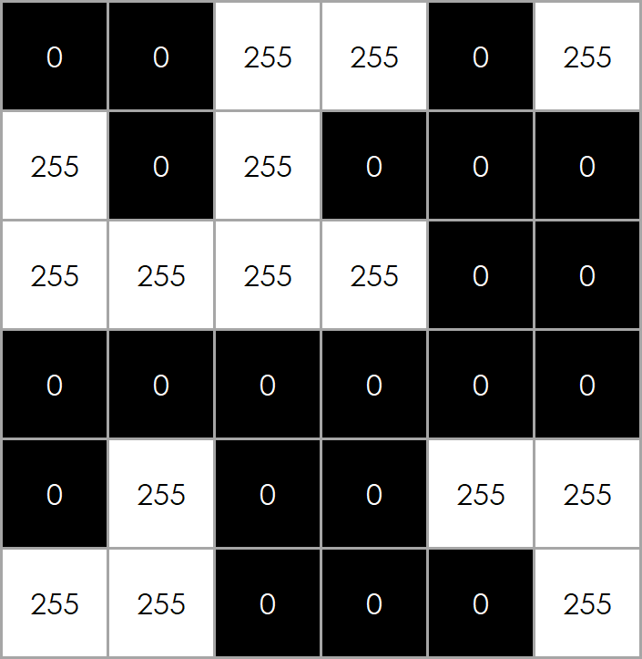
Sensor System-Visual Processor
(Example area of Canny Image)
Standard Deviation of Pixel Values
$avg=$ $\frac{1}{N}\sum_{p}{X_{p}}$
$std=$ $\sqrt{\frac{1}{N}\sum_{p}{{(X_{p}−avg)}^{2}}}$

Slide 9
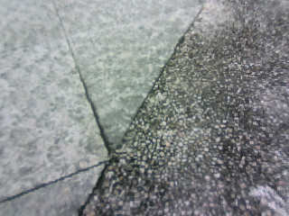

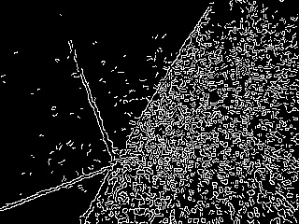
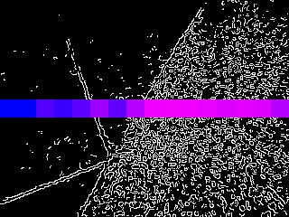
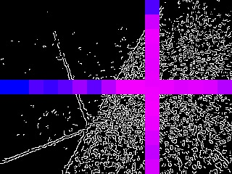
Sensor System-Visual Processor
Original Image
Grayscale Image
Canny Edges
Standard Deviation ①
Standard Deviation ②
Centroid Calculation
Image Processing Procedure
$X_{c}=5$
$X_{c}=5$

Slide 10
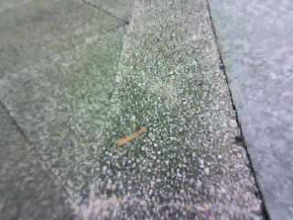
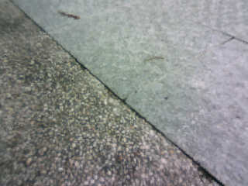
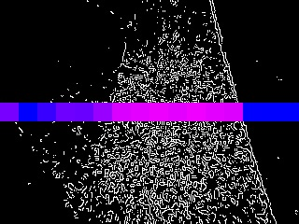
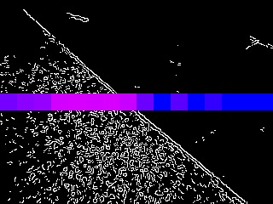
Sensor System-Visual Processor
$X_{c}=1$
$$X_{c}=−4$$
$X_{c}=5$
(Left speed $≈$ Right Speed)
(Left speed < Right Speed)
(Left speed > Right Speed)

Slide 11
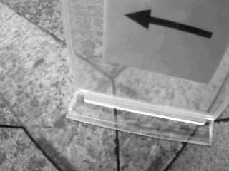
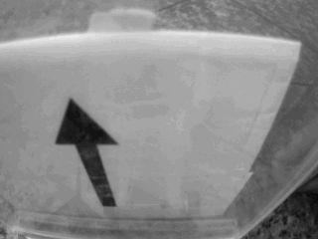
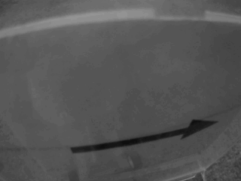
Sensor System-Visual Processor
Arrow Detection and Recognition
3
2
1

Slide 12
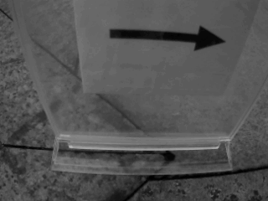
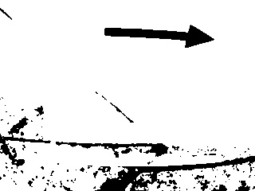
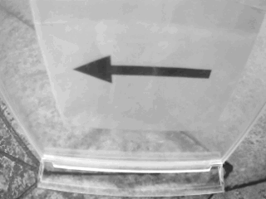
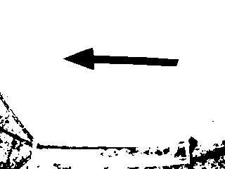
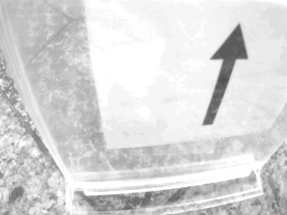

Sensor System-Visual Processor
Validation test performance
Field test performance
Validation test performance
Field test performance

Slide 13
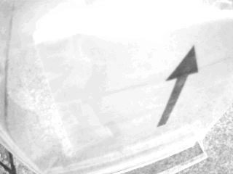


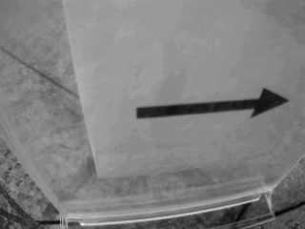


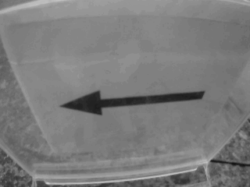
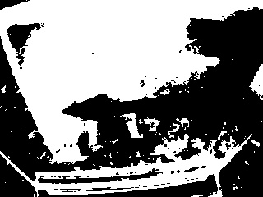
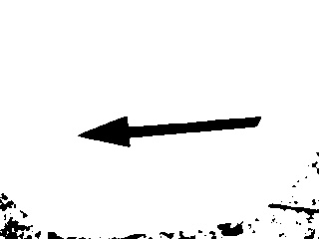
Sensor System-Visual Processor
Variable Threshold for Binarization
Original Grayscale
Fixed Threshold
Variable Threshold
(average gray level)

Slide 14
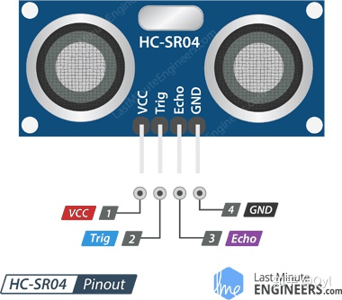
Sensor System-Ultrasonic Ranging Sensor
Its composition
An ultrasonic transmitter
and an ultrasonic receiver
How it works
1.Sending ultrasonic pulse
2.Received ultrasonic echo
3.Calculating distance
Fig.3 HC-SR04

Slide 15
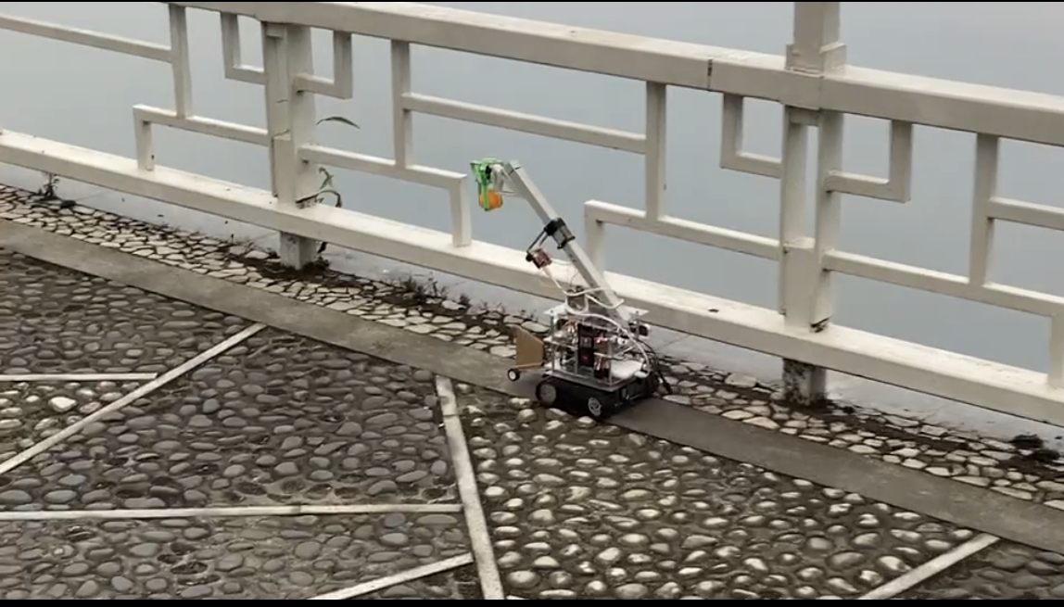
Sensor System-Ultrasonic Ranging Sensor
Functions and implementation methods in specific applications:
Detect the distance between the edge of the object and the sensor, so that
To realize the car forward, turn and other actions.
Control the action of the mechanical arm according to the different distance.
Fig.3 HC-SR04

Slide 16
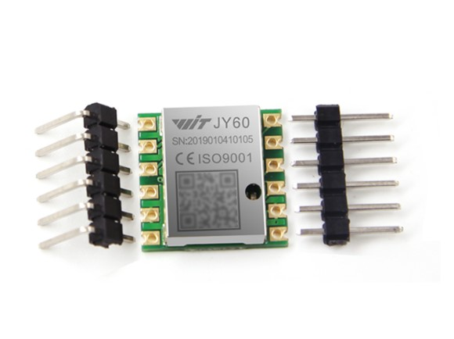
Sensor System-Accelerometer and Gyroscope
Its composition:
An angular speedometer
& and an accelerometer
How it works:
Based on MEMS technology, tiny mechanical structures are used to convert mechanical motion into electrical signals for measuring the angular velocity and acceleration of an object.
Fig.4 JY60

Slide 17
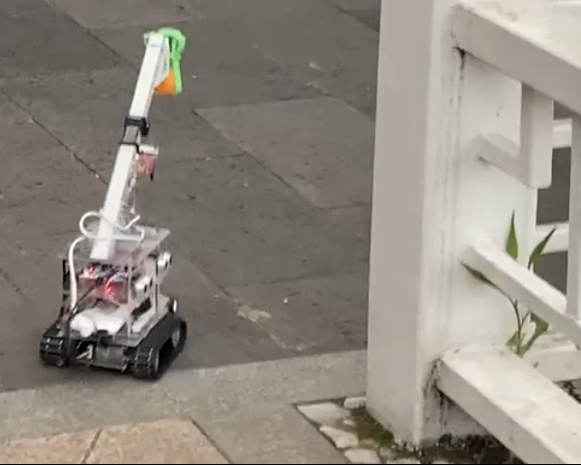
Sensor System-Accelerometer and Gyroscope
Functions and implementation methods in specific applications:
The Angle information of the car is obtained by calling the function of the JY60 module.
The rotation speed of the left and right wheels is adjusted according to the Angle information.
So that the car can keep moving in a straight line or parallel adjustment.
Fig.4 JY60

Slide 18
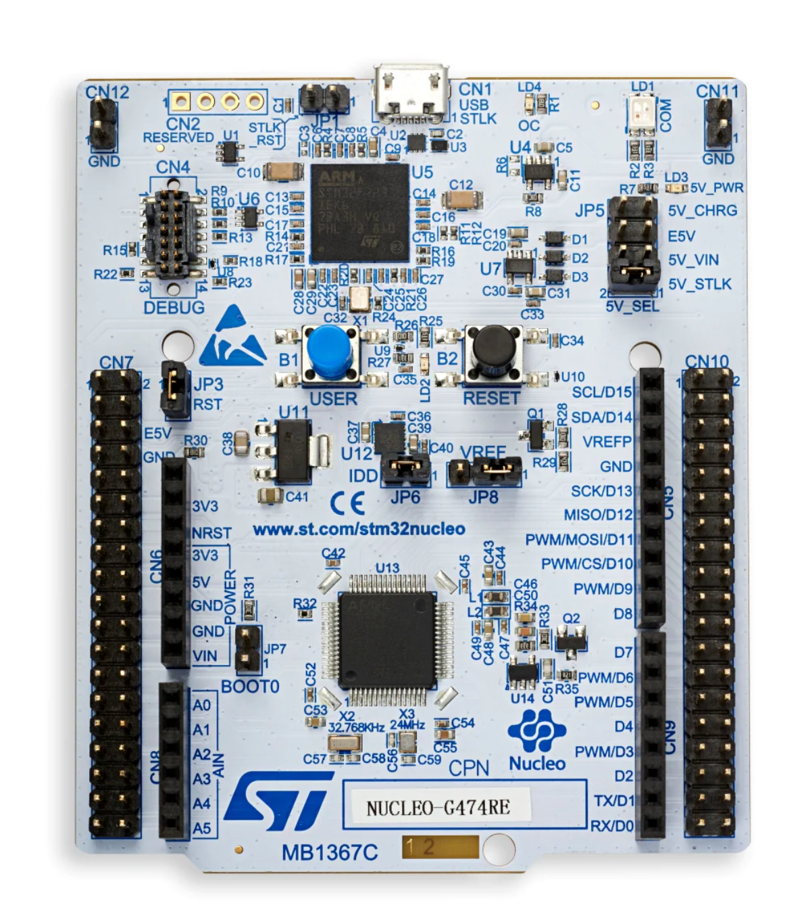
Central Control Board: NUCLEO-G474RE
What is it?
STM32 Nucleo-64 development board with STM32G474RE MCU, supports Arduino and ST morpho connectivity
Why we chose it?
More processing power and memory
Low-power modes
Wide range of peripherals
Complex task requirements
Multifunctional robot
High-performance development board

Slide 19
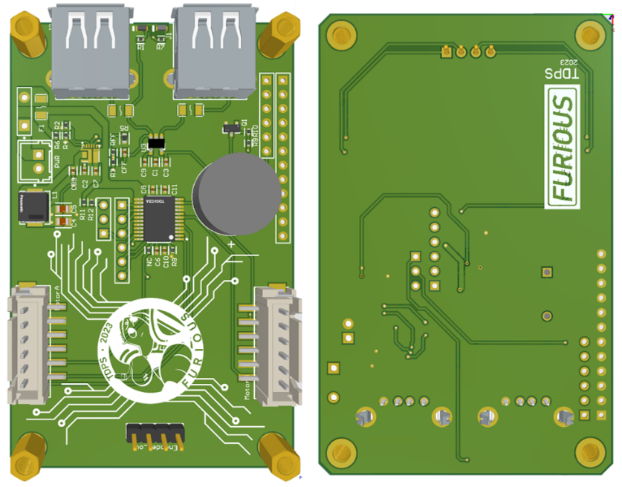
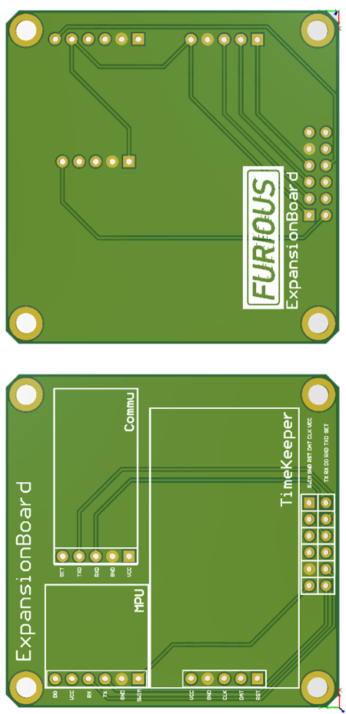
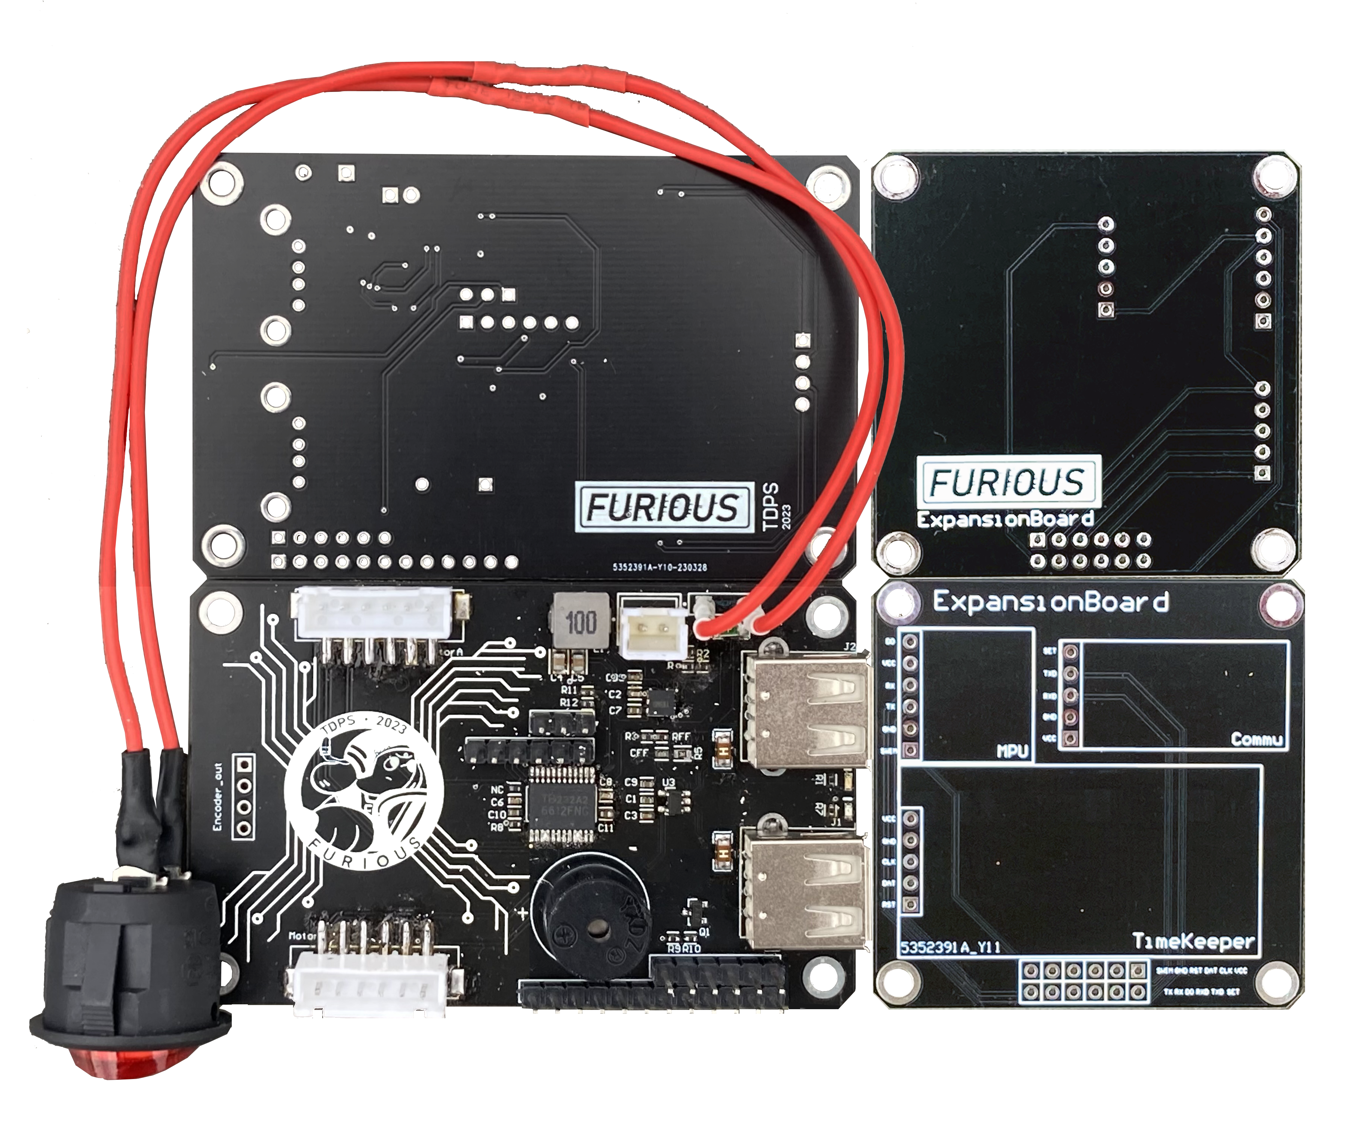
PCB Design
System Power Supply
Using only a 12V battery to provide a stable system power supply
12V to 5V & 3v3
Features power good indicator
Overall switch
3A / 1A-break fuses
Battery monitoring
Motor Driver
Controls the speed, direction, and torque of the motor
Provides isolation to protect the MCU
Expansion Board
Provides an easy and reliable interconnection to the system for the clock, MPU, and communication

Slide 20
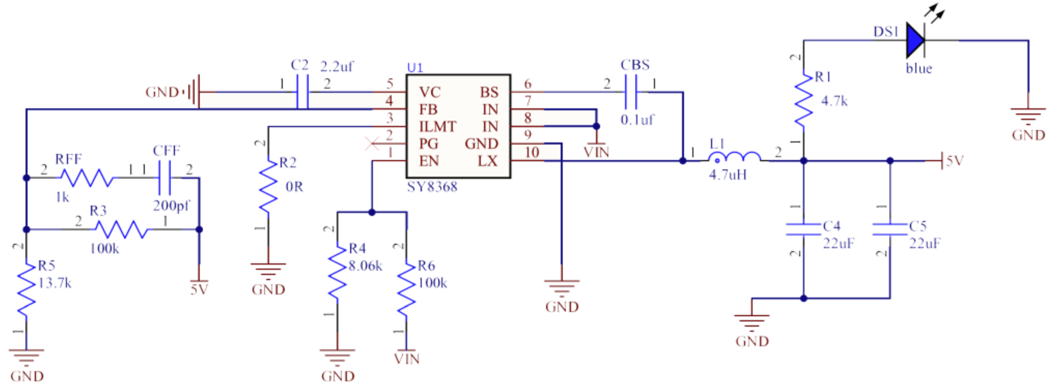
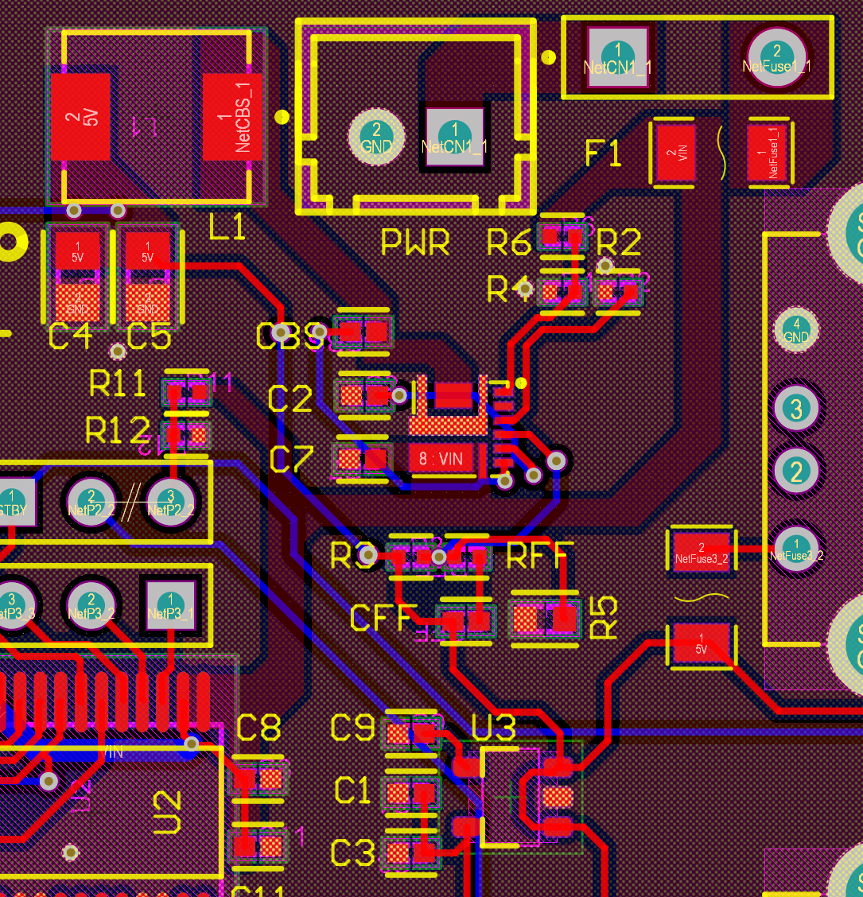
System Power Supply
Buck DC-DC regulator
LDO voltage regulator
SY8368 power management chip
ME6211 LDO chip
Efficiency
Low-ripple power supply
Appropriate designed inductors and capacitors
Well-arranged PCB layout
Battery monitoring
Protects battery, avoiding over-discharge
Potential divider for onboard ADC
Buzzer warning

Slide 21
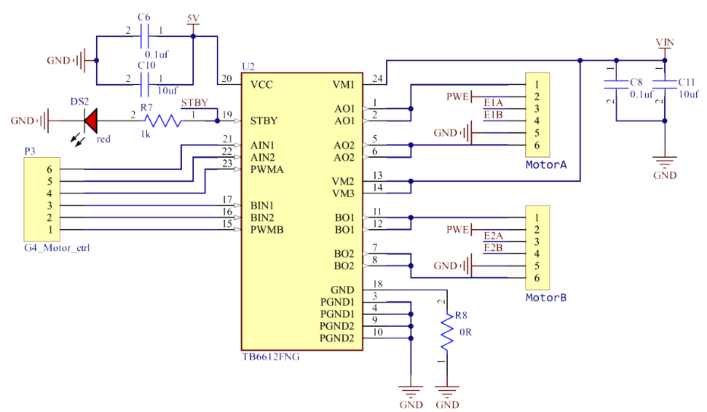
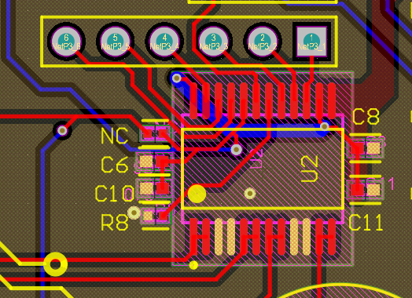
Motor Driver
Motor driver
TB6612
Dual H-bridge motor driver chip
Control two DC motors bi-directionally
Built-in kick-back diodes to protect the inductive spikes
Peak current of 3A per channel
Decoupling capacitors placed close to the power pins
Bypass capacitors placed close to the output pins

Slide 22
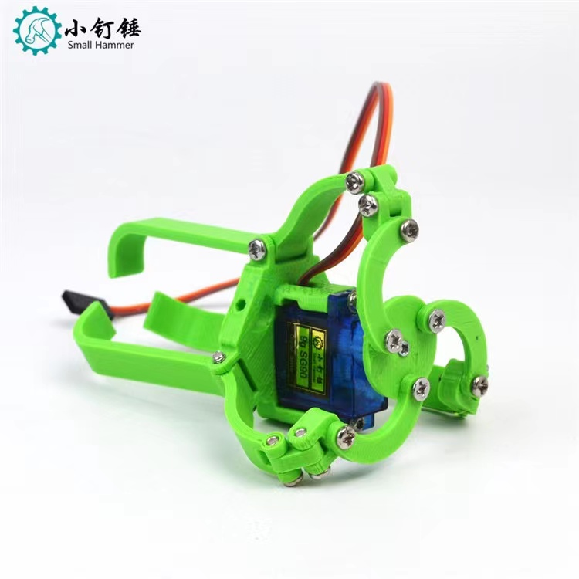
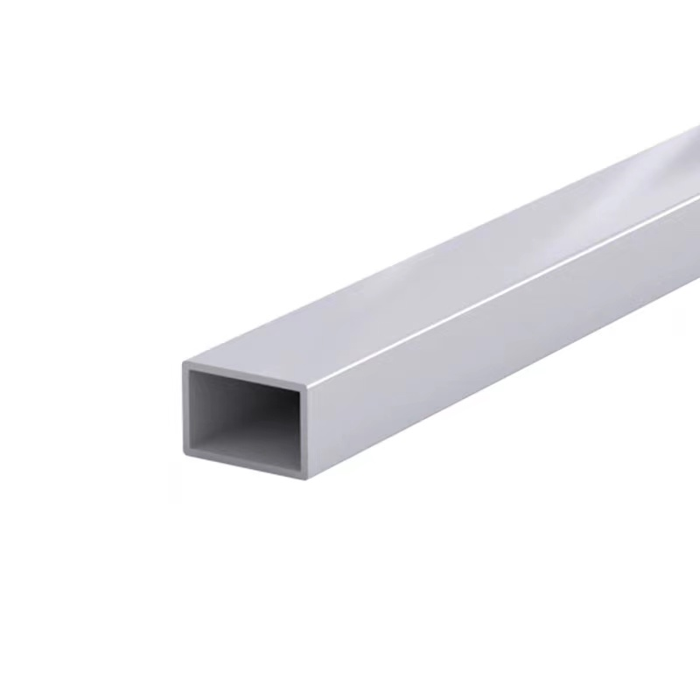
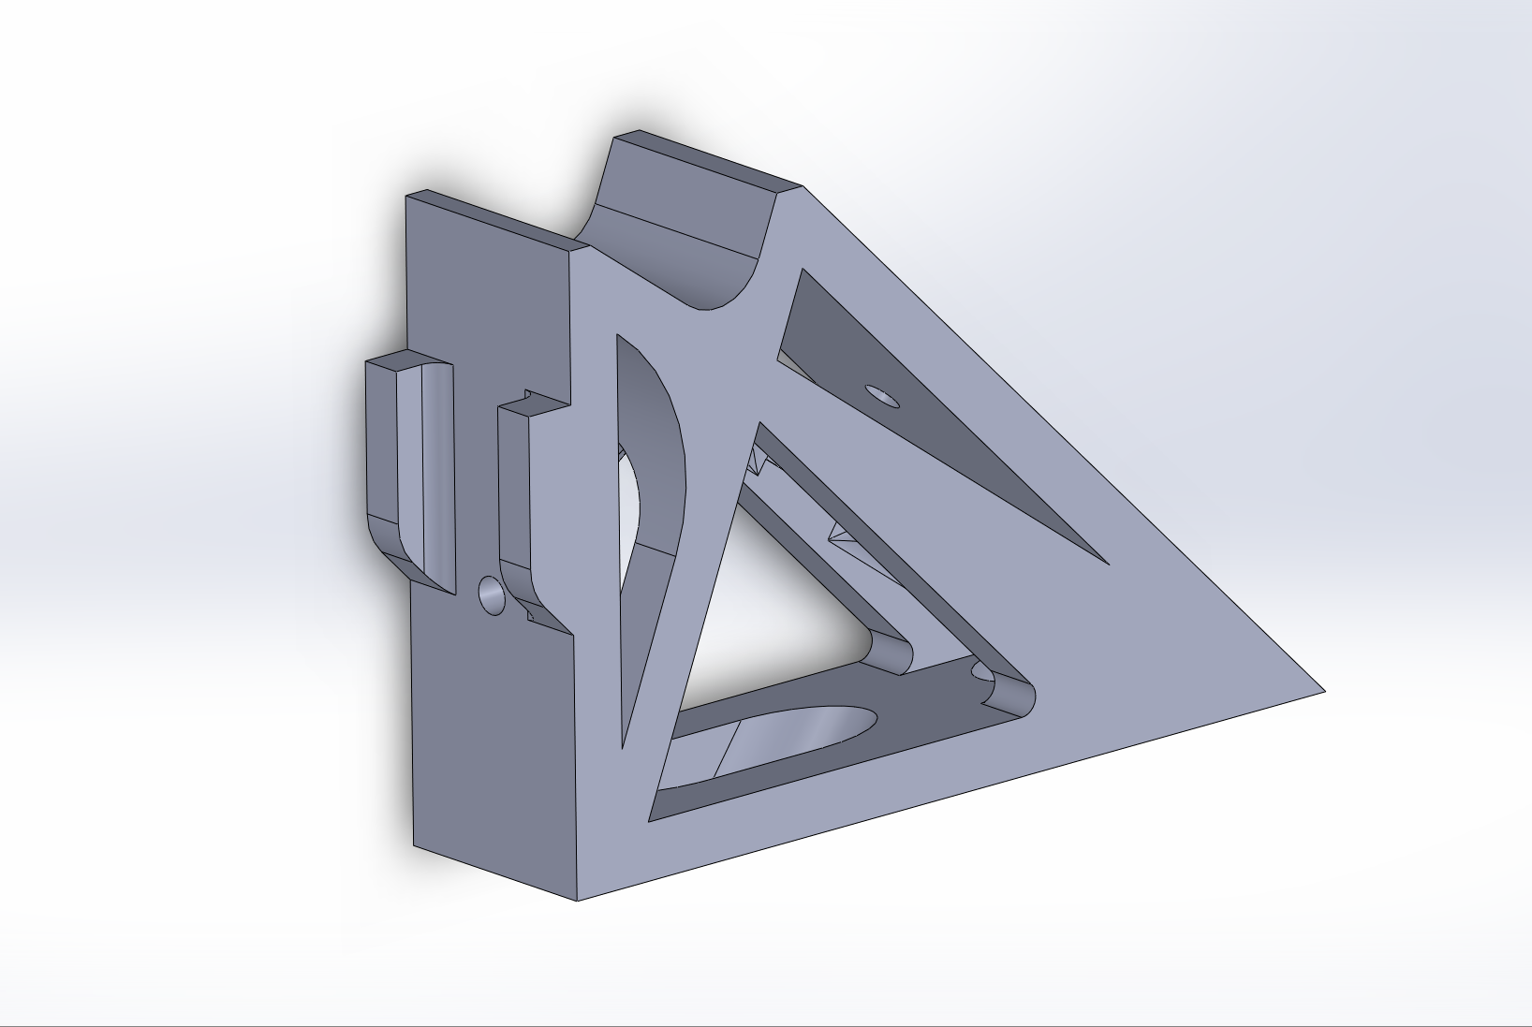
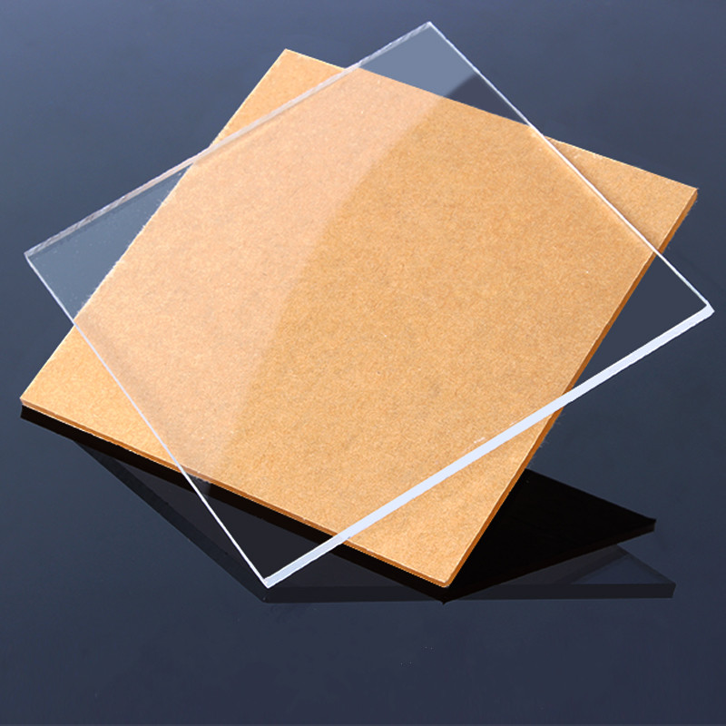
Mechanical arm
36 cm
27 cm
3-D printed craw
11cm
PVC tube
3-D printed linker
Acrylic plate

Slide 23
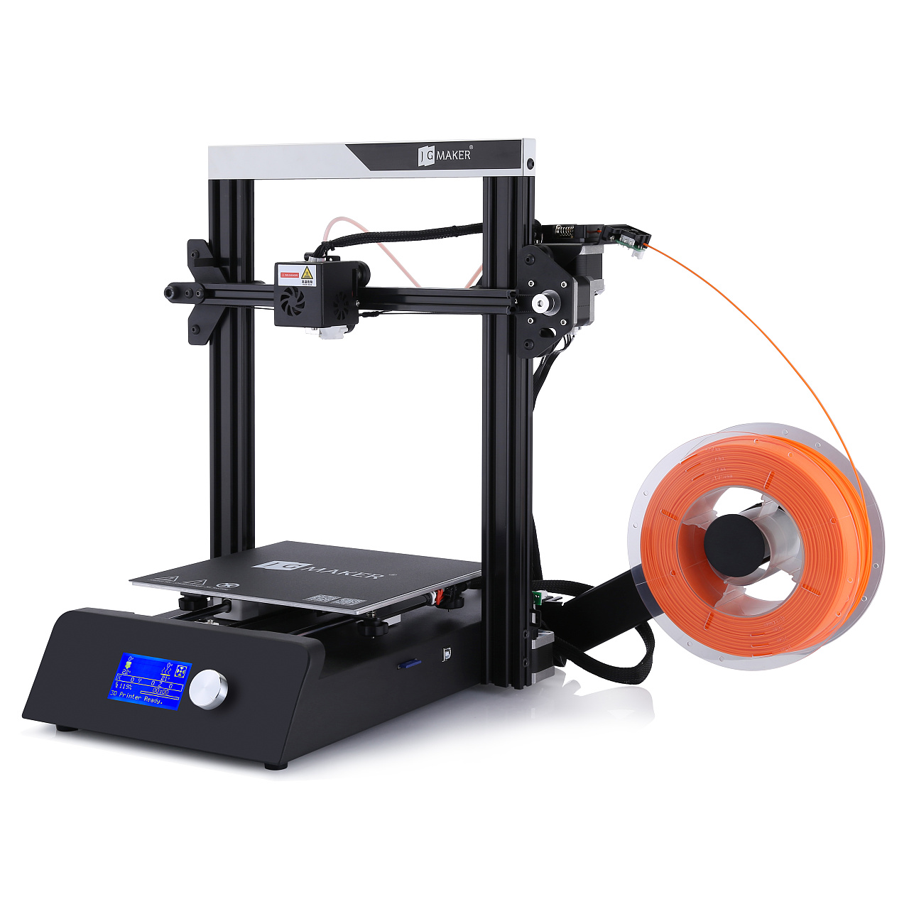
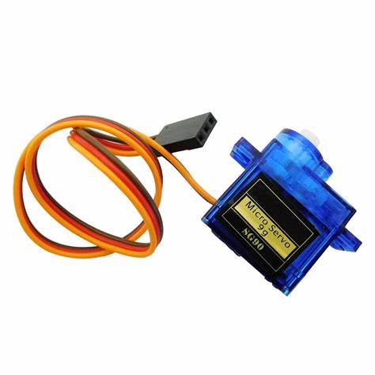
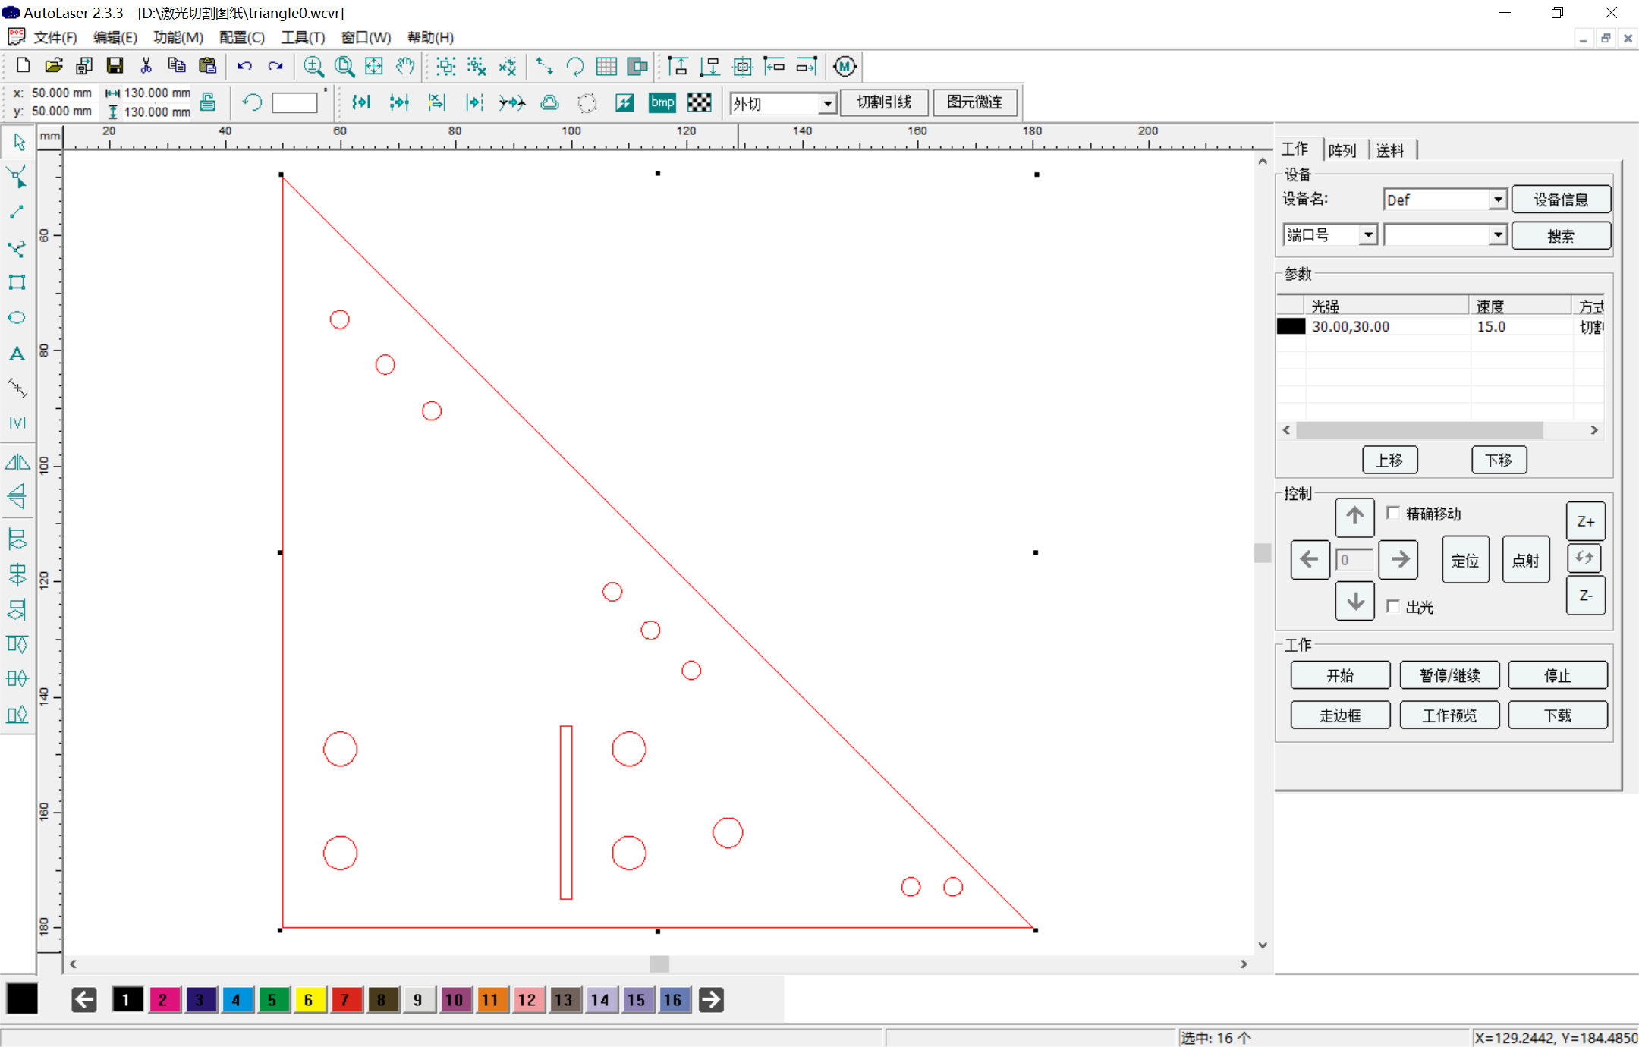
Mechanical arm
Mechanical arm
sg90
5V servo motor
Control 3-D printed craw
Connected with G474RE
20ms PWM pulse width
Angle varying from 0 to 180
Self-design & self-cut acrylic plate using laser cutting
Self-design & self-print linker
3-D printer
sg90
Laser cutting

Slide 24

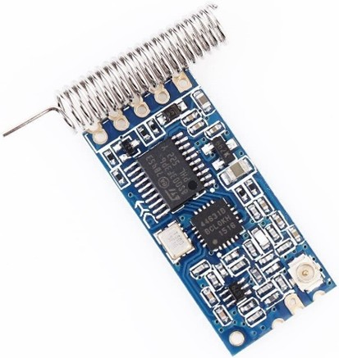
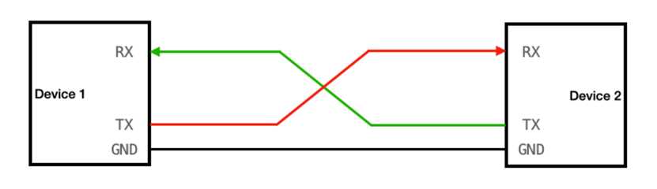
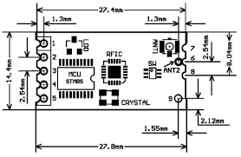
Communication System
Wireless Communication Module📶
PC or MCU
HC-12
UART Protocol
HC-12 module

Slide 25
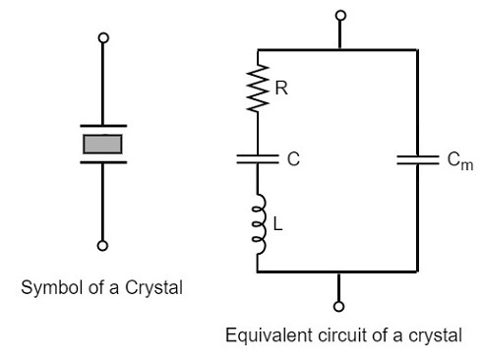
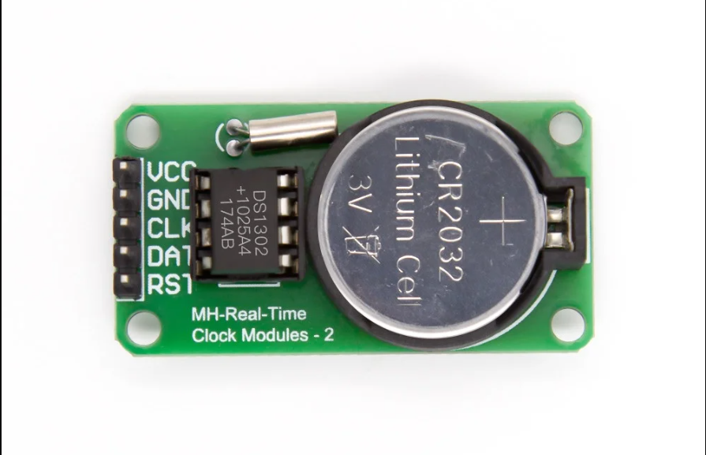
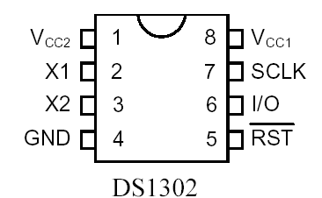
Communication System
Real-Time Clock Module🕰️
Crystal Oscillator
Equivalent Circuit of Crystal Oscillator
DS1302 module
Power Cell

Slide 26








Communication System
System Structure
UART
Control pin
UART
HC-12
HC-12
L432KC
SPI
G474RE
usb-ttl converter
DS1302

Slide 27
Robot Mechanical Structure
From the bottom to the top
Base
First layer
Second layer
Third layer
Tracks
Motor driver PCB
HC-SR04
Mechanical arm
Components
Motors
Extension PCB
Nucleo-G474RE
OpenMV
Battery
JY60
Switch
HC-12
OLED
Front support frame
DS1302

Slide 28


Robot Mechanical Structure
Base
Base
Tracks
Tracks
Motors
Motors
Battery
Battery
Front support frame
Front support frame

Slide 29
Robot Mechanical Structure
From the bottom to the top
Base
First layer
Second layer
Third layer
Tracks
Motor driver PCB
HC-SR04
Mechanical arm
Components
Motors
Extension PCB
Nucleo-G474RE
OpenMV
Battery
JY60
Switch
HC-12
OLED
Front support frame
DS1302

Slide 30
Robot Mechanical Structure
From the bottom to the top
Base
First layer
Second layer
Third layer
Tracks
Motor driver PCB
HC-SR04
Mechanical arm
Components
Motors
Extension PCB
Nucleo-G474RE
OpenMV
Battery
JY60
Switch
HC-12
OLED
Front support frame
DS1302

Slide 31
Robot Mechanical Structure
Base
First layer
Tracks
Motor driver PCB
Motors
Extension PCB
Battery
JY60
Front support frame
HC-12
DS1302

Slide 32
Robot Mechanical Structure
From the bottom to the top
Base
First layer
Second layer
Third layer
Tracks
Motor driver PCB
HC-SR04
Mechanical arm
Components
Motors
Extension PCB
Nucleo-G474RE
OpenMV
Battery
JY60
Switch
HC-12
OLED
Front support frame
DS1302

Slide 33
Robot Mechanical Structure
From the bottom to the top
Base
First layer
Second layer
Third layer
Tracks
Motor driver PCB
HC-SR04
Mechanical arm
Components
Motors
Extension PCB
Nucleo-G474RE
OpenMV
Battery
JY60
Switch
HC-12
OLED
Front support frame
DS1302

Slide 34
Robot Mechanical Structure
Second layer
HC-SR04
Nucleo-G474RE
Switch
OLED

Slide 35
Robot Mechanical Structure
From the bottom to the top
Base
First layer
Second layer
Third layer
Tracks
Motor driver PCB
HC-SR04
Mechanical arm
Components
Motors
Extension PCB
Nucleo-G474RE
OpenMV
Battery
JY60
Switch
HC-12
OLED
Front support frame
DS1302

Slide 36
Robot Mechanical Structure
From the bottom to the top
Base
First layer
Second layer
Third layer
Tracks
Motor driver PCB
HC-SR04
Mechanical arm
Components
Motors
Extension PCB
Nucleo-G474RE
OpenMV
Battery
JY60
Switch
HC-12
OLED
Front support frame
DS1302

Slide 37
Robot Mechanical Structure
Third layer
Mechanical arm
OpenMV

Slide 38
Integration
Integration
Part 3 :
From Rich(Wang Ruiqi)
Lionel(Li Yusen)

Slide 39

Patio 1
Beacon
Patio 1:
Flow Diagram
Task 1
Task 2
Task 3

Slide 40


Patio 1
Patio 1:
Flow Diagram

Slide 41

Patio 1: Difficulties and Solutions
Line tracking:
OpenMV detection
Serial communication between OpenMV and G474
Ultrasonic ranging:
Two ultrasonic modules
Increase accuracy, Reduce accidental errors
Keep straight:
JY60
Ultrasonic ranging

Slide 42
Patio 2
Patio 2 Block Diagram
Throw the table tennis ball into the basket🗑️
Recognize the arrow with OpenMV⬆️➡️⬅️
Travel to the release point
🚗
Travel to the communication area 🚗
Message with the laptop
💻
🛑Stop
with cobbled road🪨

Slide 43

Patio 2
Problems in Recognition
Throw the table tennis ball into the basket🗑️
Recognize the arrow with OpenMV⬆️➡️⬅️
Travel to the release point
🚗
Travel to the communication area 🚗
Message with the laptop
💻
🛑Stop
with cobbled road🪨

Slide 44

Patio 2
Change the recognition algorithm
Interception algorithm
Binary algorithm

Slide 45


Patio 2
Set time delay
Set the Openmv delay to ensure the correctness of communication transmission
Increase the times of recognition to ensure the correctness of recognition

Slide 46
Patio 2
Problems in Traveling
Throw the table tennis ball into the basket🗑️
Recognize the arrow with OpenMV⬆️➡️⬅️
Travel to the release point
🚗
Travel to the communication area 🚗
Message with the laptop
💻
🛑Stop
with cobbled road🪨

Slide 47

Patio 2
Simply go forward?
Go forward with the assist of gyroscope and accelerometer ✅

Slide 48


Patio 2
a: The orientation coordinate value
yaw1: The real-time orientation coordinates
Coeff: The speed difference
Stay still to obtain the orientation coordinate a
yaw1
a
a
yaw1
Adjusting the direction while moving forward
Rotate faster
(Add Coeff to the Pwmout)
Rotate slower
(Minus Coeff to the Pwmout)
Rotate faster
(Add Coeff to the Pwmout)

Slide 49



Patio 2
Just go forward with the assist of gyroscope and accelerometer🚗
Walking on the cobbled road🪨
Initial route
Simplified route

Slide 50
Team-organization & time schedule
Team organization
Part 4 :
& time schedule
From Leo(Peng Yankai)

Slide 51
Team organization and time schedule
Organizes team meetings to monitor team progress
“8” plenary meetings
“8” meetings within construction group
“6” meetings within clerical group
Dynamic planning team members' tasks
Situation-based task allocation
Ensuring a good working atmosphere in the team
Supportive
Tolerant
Encouraging

Slide 52

Team organization and time schedule
Stage 1: March 1 – March 19
Task | Team members
Robot car frame construction & PID | Ruiqi Wang
Visual processor(OpenMV) | Jiaqi Wang, Ruixuan Li
Motor driver & Power circuit | Jingrui Liu, Yu Zeng, Jiaqi Luo
Wireless communication module | Yusen Li, Jinyang Zhang, Yankai Peng
Mechanic arm | Yixiao Guo
Stage 2: March 20 – March 31
Task | Team members
Robot car frame construction & PID | Ruiqi Wang
Visual processor(OpenMV) | Jiaqi Wang, Ruixuan Li
Motor driver & Power circuit | Jingrui Liu
Wireless communication module | Jinyang Zhang, Peng Yankai
Mechanic arm | Yixiao Guo
Initial report & Notebook & Presentation | Yu Zeng, Yankai Peng, Jiaqi Luo
Stage 4: May 15 – June 2
Task | Team members
Patio 1 field experiment | Ruiqi Wang, Jiaqi Wang, Jingrui Liu
Patio 2 field experiment | Yusen Li，Yixiao Guo
Final report Final Presentation | Yu Zeng, Yankai Peng, Ruixuan Li, Jiaqi Luo, Jinyang Zhang
Stage 3: April 1 – April 30
Task | Team members
Patio 1 Realization | Ruiqi Wang, Jiaqi Wang, Jingrui Liu
Patio 2 Realization | Yixiao Guo, Yusen Li, Jinyang Zhang
Final report | Yu Zeng, Yankai Peng, Ruixuan Li, Jiaqi Luo

Slide 53

Team organization and time schedule
Gantt chart
The financial record of the team
Item/Component | Unit Price￥ | Number | Price ￥
OpenMV | 429 | 1 | 429
Ultrasonic wave module | 5.53 | 3 | 16.59
Clock Module | 3.44 | 1 | 3.44
Chassis | 176.58 | 1 | 176.58
HC-12 | 11.8 | 2 | 23.6
Nucleo-G474RE | 145 | 1 | 145
Aluminum Post | 2.2 | 10 | 22
Acrylic Plate | 1.15 | 15 | 17.25
Mechanical Claw | 27.45 | 1 | 27.45
PCB | 7.6 | 1 | 7.6
PVC Tube | 49 | 1 | 49
JY60 | 4.8 | 5 | 24
Lithium Battery | 39.8 | 1 | 39.8
Other consumables |  |  | 12
Total |  |  | 993.31

Slide 54
Reference
https://book.openmv.cc/assets/002.jpg
https://th.bing.com/th/id/OIP.RvD_nfhnC8S103dxpeNlxAHaDk?w=350&h=168&c=7&r=0&o=5&dpr=1.3&pid=1.7
https://pic2.zhimg.com/80/v2-83854fa2d3181e0ad576e0f4685cc665_720w.webp
https://cdn.nlark.com/yuque/0/2022/jpeg/26313899/1649490318928-1fb191c4-df46-4ec6-9f55-595f36159fd3.jpeg
https://robotools.in/wp-content/uploads/2022/02/DS1302-RTC-Real-Time-Clock-Module-with-Battery-2.webp
https://www.st.com/bin/ecommerce/api/image.PF267026.en.feature-description-include-personalized-no-cpn-medium.jpg
https://d2t1xqejof9utc.cloudfront.net/screenshots/pics/e6672a10992ea1677a46e174d8a2b4da/large.png
https://ae01.alicdn.com/kf/H8a5f9057ed4444519b474a9091a70b89d.jpg
https://www.google.com/url?sa=i&url=https%3A%2F%2Fwww.elfa.se%2Fen%2Fstm32-nucleo-board-256kb-64kb-st-nucleo-l432kc%2Fp%2F30176568&psig=AOvVaw1C8rxSKEcvvRMfGb9zLKlO&ust=1685786177202000&source=images&cd=vfe&ved=0CBEQjRxqFwoTCLCnx-zLpP8CFQAAAAAdAAAAABAG

Slide 55
Q & A
Thanks 🎉🎉🎉
🚗
🚗
🚗

